Slide 1
Timeline of Data Access Capabilities at Penn Medicine
Expand Population Health &
Value Based Care
EPIC Cosmos – Research Network
Penn Data Lake
EPIC Caboodle - Integrated EMR DW
Analytics Self-Service Storefront
Princeton Medical Center
Consolidate EMR
Pathways of Care
Executive Analytics Prioritization
Enterprise Registries and Alerts
EPIC - Fully Integrated EMR
Data Access Capabilities
Common Dashboards for Ambulatory KPI’s
Consolidated Data Access Requests Across Organization
Consolidate and Expand
Data Access Resources
Integrate External Claims Data
CCH and Practices
TriNetX - Research Network Facilitating Clinical Trial Recruitment
Integrate Phenotype and Genotype Data
PennOmics - Research Data Warehouse
Executive Analytics Governance
PennSeek - Search and Discovery of Clinical Notes
DAC - Centralized Data Access Team
Specialized Datamarts and Dashboards
PDS - Aggregate Patient Data into EDW
Financial DW
EPIC - Common Ambulatory Applications
2005
2009
2010
2011
2012
2013
2014
2015
2016
2017
2018
2019
2020

Slide 2
Data Analytics/Access Center (DAC) shared enterprise resource
Patrick Farrell, Senior Director
Nebo Mirkovic, Associate Director
1 Enterprise Data Architect; 1 Solutions Architect
Data Architecture & Development Team
Data warehousing (SQL, HANA , Hadoop), models, marts, feeds
Brent Moore, Senior Manager
4 Data Architects, 14 Data Engineers
Reporting & Research Analytics Team
Data analysis and visualization (reports, dashboards), registries
Liat Shimoni, Senior Manager
19 Information analysts/report developers (3 leads), Scrum masters
Product Development & Optimization Team
Long-term solutions, application implementation and ownership
Amy Trenton, Business Manager; Jesse Zlatsin, Manager
4 Product owners, 2 Dev-Ops analysts, 2 Dev-ops engineers

Slide 3
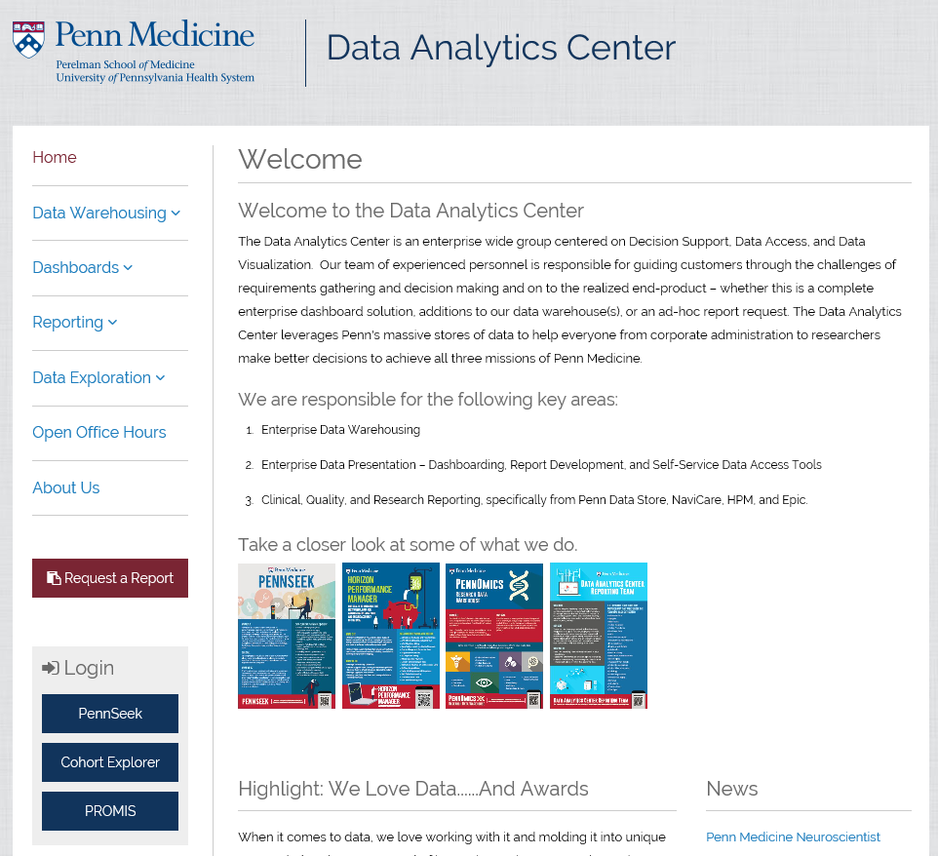
Data Analytics/Access Center (DAC) https://www.med.upenn.edu/dac

Slide 4
DAC Strategic Initiatives FY2018
Technology Focus
Epic Caboodle
Analytics Operational Store
Consolidate data visualization solutions
Reevaluate data mining and discovery tools
New research platform
People Focus
Collaborative relationships (IBI, PennChart team, CV service line, CPUP Operations, Professional billing office, etc.)
PennChart Analytics team
Educational outreach
Staff training: Epic, domain knowledge, data science, cloud, new technologies

Slide 5
Data Available Through Epic Clarity and/or PDS
demographics
visits
scheduling
provider Info
allergies
orders
Rx
procedures
MAR
vaccinations
coded diagnoses
problem list
history
notes
flowsheets
labs
blood
bank
POC services
radiology reports
pathology reports
endoscopy reports
ECG reports
echo reports
cath reports
electrophys reports
RadOnc
patient
flow
CTMS
hosp. acq. infections
transplant
labor & delivery
anesthesia
PeriOP
geolocation
patient surveys
SSA
DMF
tumor stage and grade
oncology infusion
genomic data
hospital & prof. billing
general ledger
external claims
other financial

Slide 6
Data Access & Analytics Governance
Strategic Direction Review
with Executive Leadership
(Bi-Monthly)
Prioritization of Data Access
with Executive Leadership
(Monthly)
Stewardship of Domain Data and Metric Definitions
Hospital operations, ambulatory, finance, QI, research
Dashboard & Reporting Governance
Stewardship and education related to data visualization
Data Architecture
Stewardship of technologies enabling data access and analytics

Slide 7
Data Access Request Types
Clinical Care, Operations, Quality Improvement
All necessary information
Provision mode: reports, dashboards, data files
Preparatory Research
Aggregates, counts
Provision mode: reports, self-service applications (PennOmics)
IRB Approved Protocols
All approved elements of PHI
Provision mode: data files, self-service applications (PennSeek, PennOmics)

Slide 8
Clinical Care, Operations & QI Support
Dashboards
(interactive) visualization of quality and performance metrics
PennChart Internal Registries
cohorts of Penn patients and metrics related to them
SAP Universes & Web-Intelligence
Universe – semantic layer that interprets raw data through business rules, created for general purpose analysis or to drive focused analysis applications
WebI – reporting tool used to display data from Universes

Slide 9
Internal Penn Registries in PennChart www.med.upenn.edu/dac/registries
ACTIVE
Collaborative Care Behavioral Health Cancer (P Gabriel)
ESS/Trauma
Interstitial Lung Disease (M Porteous)
Irritable Bowel Disease (C Klock)
Major Lower Joint Replacement (J Piscitello E Hume)
Medicare Advantage (JT Howell)
Opioid Therapy (M Ashburn)
Princeton Horizon (T Fisch)
Sickle Cell (D Christopher)
Stroke (L Leibowitz)
Superutilizers (JT Howell, S Honeywell)
UPHS IBC Warranty (G Kruse, C Vanzandbergen)
UPHS Inpatient Readmission
ACO (JT Howell)
ACS NSQIP (S Diem)
Adult HIV (A Norris)
Anesthesia Record
Asthma (A Apter)
Case Management
Chronic Care Management (JT Howell)
Congestive Heart Failure (L Goldberg)
COPD (M Sims)
Coronary Artery Disease
Diabetes (M Schutta)
Emergency Encounters (C Edwards)
Hypertension (R Townsend)
Osteoporosis
Wellness Registry-All (JT Howell)
Build In Progress: CPC+, MBSAQIP
Build Planned: Roster Management, ICU, ICU-Sepsis (sub), Penn Metabolic Medicine, Heart Safe Motherhood, ACS NSQIP, ACS TransQIP, Active Patients

Slide 10
Research Request Process
Report Request
Finalize Requirements
Interactive finalization of specifications
Development/ Delivery
Initial report development and delivery
Refinement as needed
Obtain IRB Approval (if applicable)
Compliance Review
Complete request form (initial requirements)

Slide 11
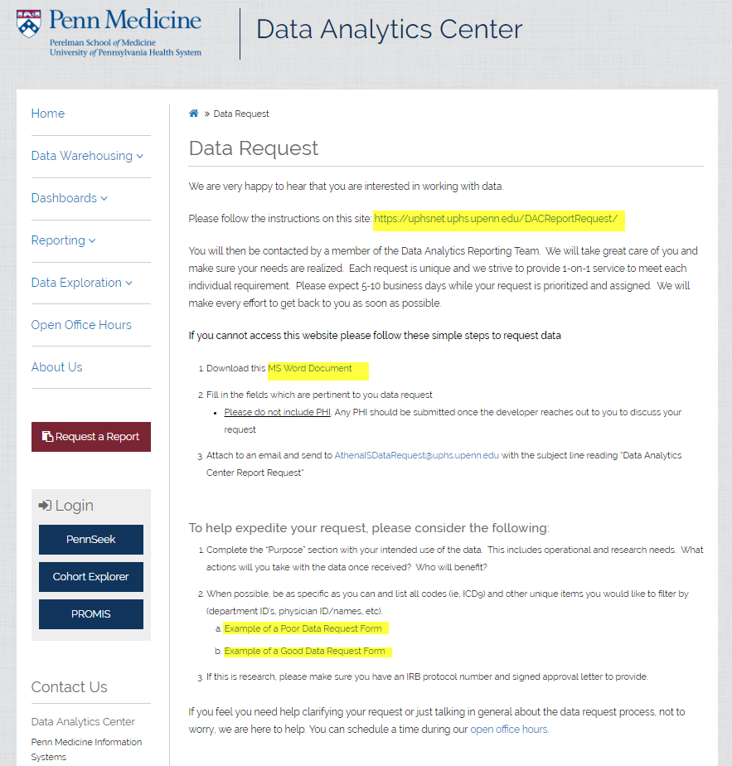
DAC Data Request Form

Slide 12
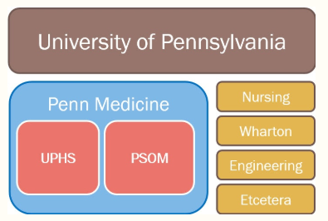
Covered Entity
- only Penn Medicine staff allowed to see PHI without legal contract
- third parties may see de-identified data, and are required to sign Data Use Agreement (DUA)

Slide 13
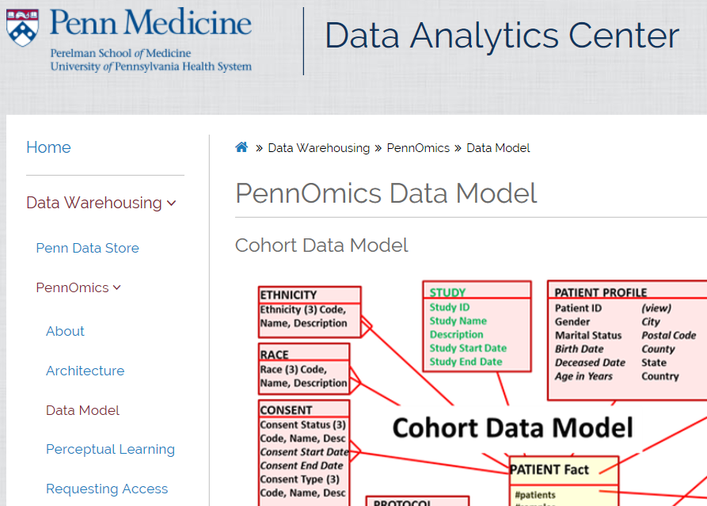
PennOmics https://pennomics.med.upenn.edu
Components:
Cohort Explorer / Translational Research Center (TRC)
Oracle Healthcare DW Foundation (HDWF)
Healthcare Data Model (HDM)
Omics database (ODB)
Cohort Data Mart (CDM)
Oracle Healthcare Analytics Data Integration (OHADI)
Oracle Data Integrator (ODI)

Slide 14
PennOmics - Data Flow
Clinical Data
Tumor Registry
Cohort Explorer
EHR
PennOmics
Oracle Healthcare Data Warehouse
CTMS
Genomic Data
Center for Personalized Diagnostics
API Access
Internal Research Labs
Reference Datasets

Slide 15
PennOmics - Data Classes
Data class | Data Since
Patients | 2005
Encounters | 2008
Medications | 2008
Diagnosis | 2008
Procedures | 2008
Labs, microbiology | 2008
MAR | 2008
Vitals | 2011
Tumor Stage & Grade | 2010
Studies | 2001
Clinical Genomics (CPD, PMBB) | 2013
Research Genomics (CNDR) | Various

Slide 16
PennSeek
Based on Oracle Endeca
Intuitive e-shopping-like user interface
Reduces data sourcing burden
Reduces data abstraction turnaround by up to 80%
Inspires unanticipated questions

Slide 17
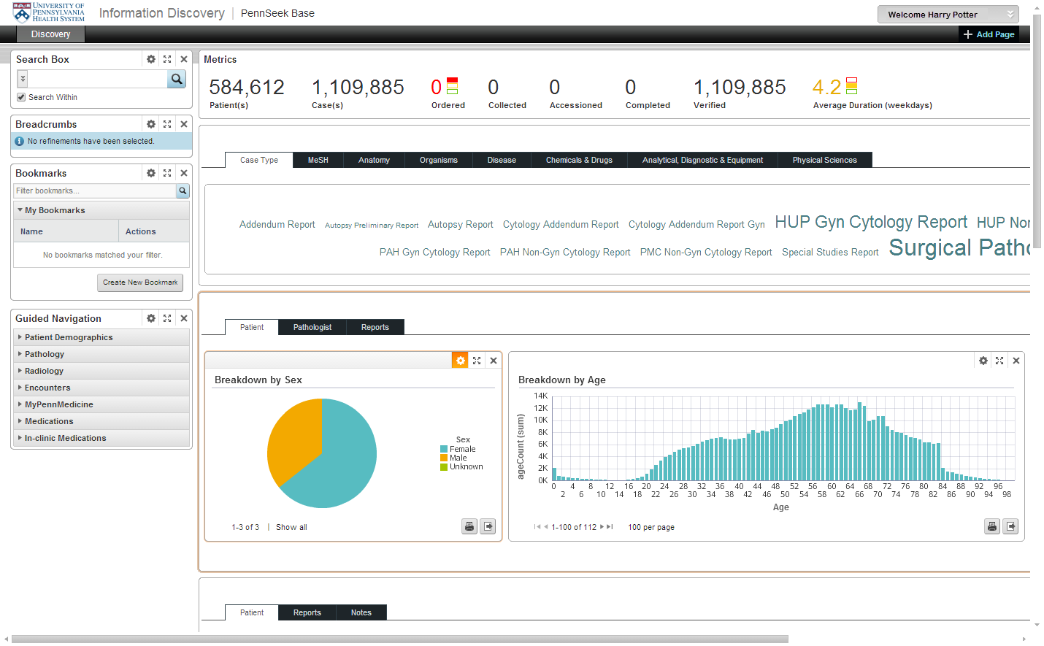
PennSeek - User Interface

Slide 18
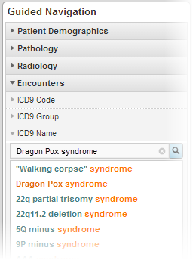
PennSeek - Guided Navigation

Slide 19
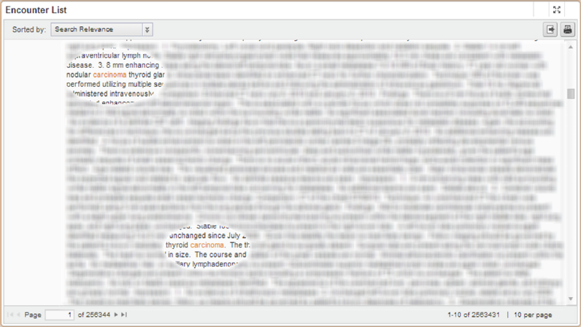
PennSeek - Search Terms Highlighted in Context

Slide 20
TriNetX https://live.trinetx.com
Global research network: 11 countries, 100M patients, ~70 HCOs (e.g. Penn, TJ, Drexel, Temple, Penn State)
Over 50% of CTSA program hub sites use TNX
Optimizes / lowers cost / speeds up clinical research design and patient recruitment
Value to participants:
Attract sponsored studies from pharma and CROs, by finding and recruiting patients that match protocol criteria
Free-of-charge (TNX provides servers)
Design protocols with inclusion and exclusion criteria

Slide 21
TriNetX https://live.trinetx.com
Penn Data: Demographics, Encounters, Px, Dx, Rx, Labs, Cardiology tests (LVEF, QTc, NYHA), some Vitals, PFT, Tumor Registry data
TNX schema can incorporate genomic data
Data mapped onto standard vocabularies (HL7, LOINC, NDF-RT, RxNorm, CPT, ICD, ICD-O)
Data Security: data stays behind Penn firewall, data de-identified, pharma see only counts (rounded), cannot search by ZIP, HCO sees only own patient-level data

Slide 22
Clinical Data Access for PSOM Researchers
Access Point | Access Type | Data Available | Time for access prerequisites | HIPAA training? | CITI training? | UPHS account required | IRB approval required
PennOmics | Web dashboard, self-service | de-identified clinical data no clinical notes some genomic data (upon request) | < 1 week | Yes | No | No | No
PennSeek | Web dashboard, self-service. | identifiable clinical data, including free-text notes | 7-8 weeks | Yes | Yes | Yes | Yes
Custom Data Requests | Work with UPHS data analyst who retrieves data and provides in desired format. | identifiable clinical data >10k tables in EPIC Clarity PDS: subset of EPIC, historical and current non-EPIC Schemas and dictionaries: www.med.upenn.edu/dac/penn-data-store-warehouse.html | 1-2 weeks for simple requests, highly variable for complex requests | No | No | No | Yes, unless requesting aggregate or deidentified data

Slide 23
DAC contacts
Custom Reporting
Info: http://www.med.upenn.edu/dac/about-reporting.html
Requests: http://www.med.upenn.edu/dac/data-request.html
Support: yuliya.borovskiy@pennmedicine.upenn.edu
Open Office: Tuesdays 1-4pm (schedule at least week before)
PennOmics
Info: www.med.upenn.edu/dac/cohort-explorer.html
Training:
https://performancemanager4.successfactors.com/sf/learning?company=71508P&_s.crb=Pr1juTwaOuTClazXhmXHVWiU85I%253d
Owner: nebojsa.mirkovic@pennmedicine.upenn.edu
Support: patrick.sullivan@pennmedicine.upenn.edu
PennSeek
Info: www.med.upenn.edu/dac/pennseek.html
Owner: nithya.seshadri@pennmedicine.upenn.edu
Support: pennseek@uphs.upenn.edu

